Slide 1

Strategic Marketing with Predictive Modelling
AGENDA
Business Problem
Objective
Modelling Approach and Capabilities
Risks, Bias, and Ethical Considerations
Key Results and Business Impact ​​
App Demo Video
Future Work & Deployment Strategy
Rituparna Bera
University of Toronto
Data Science Institute
July 26, 2025
COHORT 6
ML TEAM 7
Notes:
Rehan - 45 seconds - 44 sec
Hello, we are team 07 for machine learning, and we explored strategic marketing with predictive modelling. Our group members are as follows:
Raj
Feihong
Darling
Rehan
Ritu &
Jennifer
We will be walking you through how we used machine learning to improve a bank’s term deposit campaigns.
Banks often struggle to identify which clients will actually respond to marketing campaigns. That was the situation we were tasked with, our goal was to build a predictive model to target the right clients, those most likely to subscribe. We cleaned the data, trained several models, and interpreted the results to design a solution ready for business use.
The result? A smarter, more efficient marketing strategy that saves time, cuts costs, and boosts conversion.

Slide 2



Business Problem
How do we reduce outreach while maintaining results
45, 000 clients
$ 140,000
5,000 conversations
Objective
Predict and prioritize likely subscribers before initiating outreach
COHORT 6
ML TEAM 7
Notes:
Rehan - 30 sec - 30 seconds
Let’s shift gears and look at The Business Problem, A Portuguese bank launched a phone-based term deposit campaign to over 45,000 clients. Agents contacted 60 people per day for two months, spending around $140,000 USD in the process.
Only 5,000 clients subscribed.
The business challenge here is clear: how do we reduce outreach while maintaining results? We wanted to build a model that predicts which clients are likely to subscribe before any calls go out, so campaigns can focus on high-potential leads and avoid wasting resources.

Slide 3
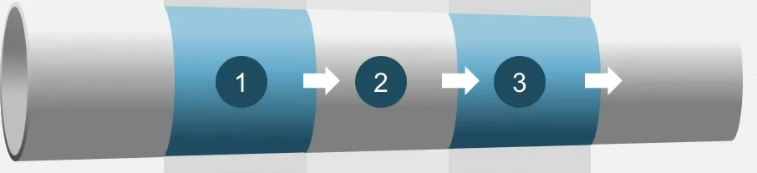

Modelling Approach and Capabilities
Our End-to-End Data and Modelling Pipeline
Raw data
Cleaning
Encoding
Training
Evaluation
Feature | Mean | Min | Max | Notes
Age | 40.9 | 18 | 95 | Wide age range
Balance | 1362.27 | -8019 | 102127 | Strong right-skew; outliers present
Duration | 258.16 | 0 | 4918 | Duration of last contact (very predictive, but not usable pre-call)
Campaign | 2.76 | 1 | 63 | Number of contacts during campaign
Pdays | 40.2 | -1 | 871 | -1 indicates no prior contact
Previous | 0.58 | 0 | 275 | Number of contacts before this campaign
COHORT 6
ML TEAM 7
Notes:
Fei - 45 seconds - 38 seconds
Now let’s explore The Modelling Approach and Capabilities. We worked with the Bank Marketing dataset, which included features like age, job type, and past campaign outcomes.
Our goal was to predict which clients would subscribe before making a call. We cleaned and encoded the data, scaled numerical features, and tested models like Random Forest, Decision Tree, and Neural Network. Neural Network gave the best performance.
Importantly, we excluded the ‘duration’ variable, since it’s only known after a call, making our model realistic for actual pre-call targeting.

Slide 4
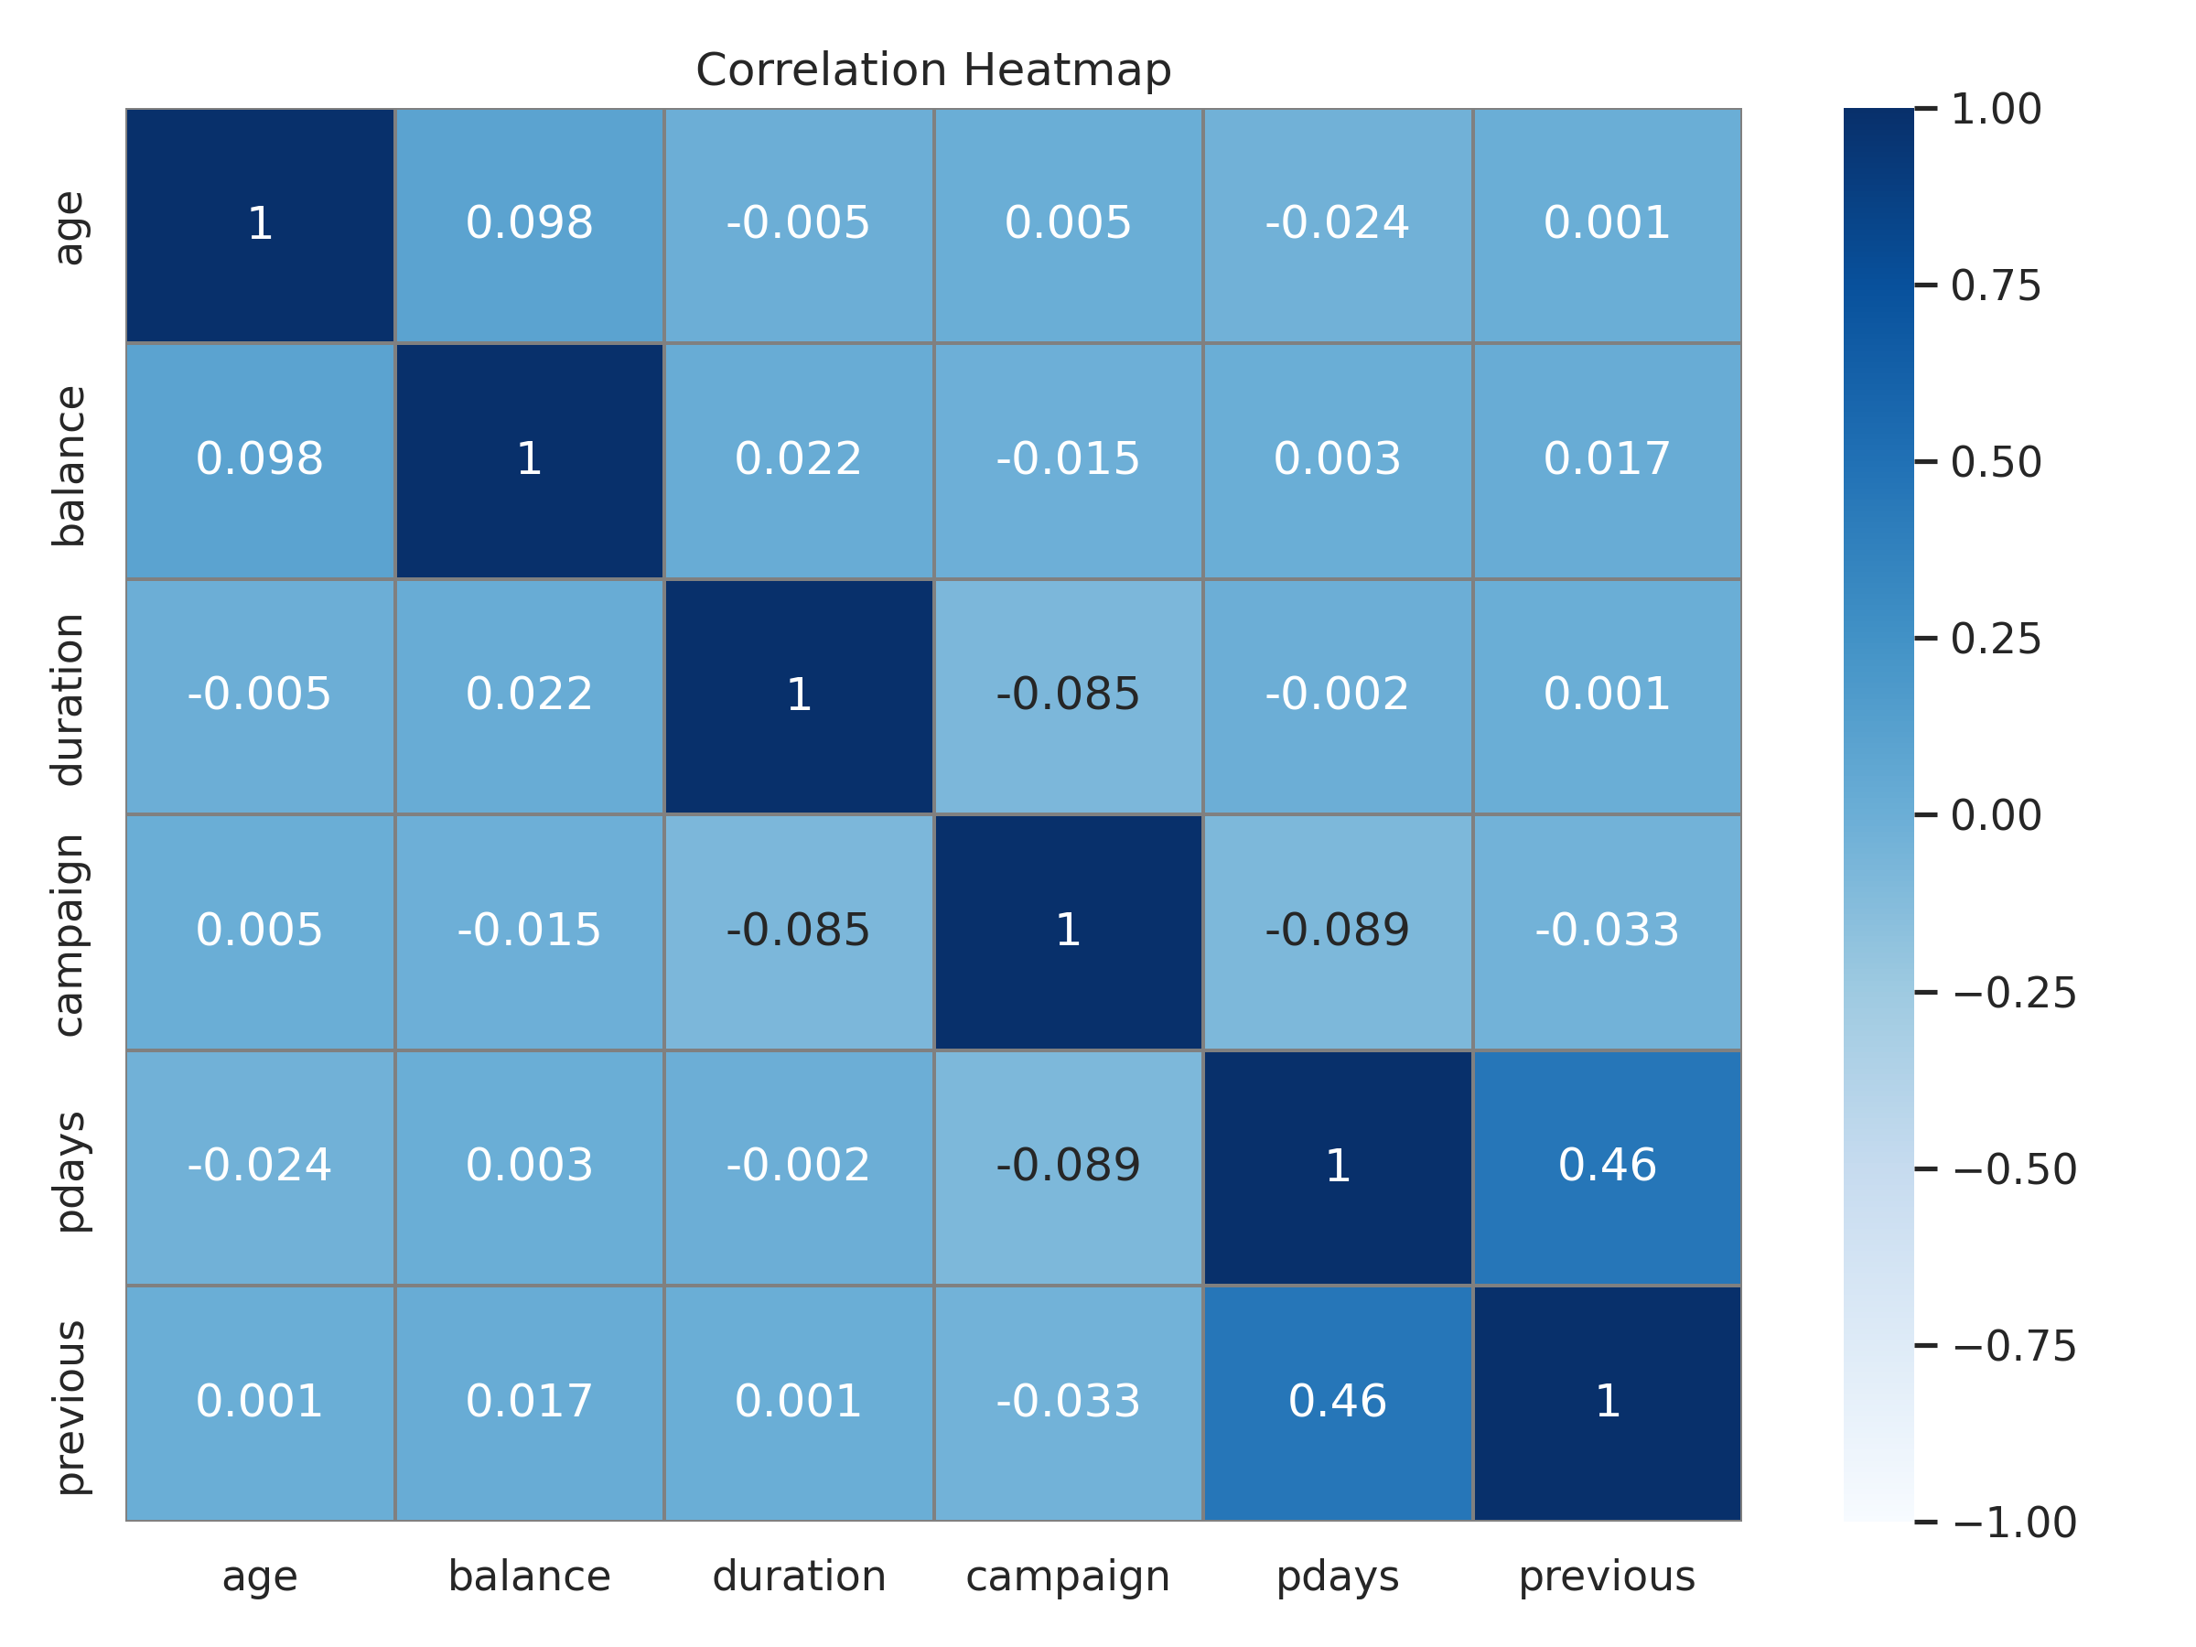
​​Risks, Bias, and Ethical Considerations
High Accuracy, Real Efficiency
Fairness Checklist:
Duration excluded
SMOTE used for class balance
Sensitive features reviewed
Mitigation strategies:
Potential risks and biases including race, gender, and socioeconomic status.
COHORT 6
ML TEAM 7
Notes:
Jennifer - 45 sec - 42 seconds
With that foundation, we move to introduce some risks, bias’s and ethical considerations.
We understand that building predictive models isn’t just about accuracy, it’s also about fairness, responsibility, and trust.
As we move forward, we’re planning to carefully assess features like age and job type, which may introduce unintended bias,
even if they’re not highly predictive.
We’re excluding ‘duration’ because it’s only known after a call, and using techniques like SMOTE to address class imbalance.
Our goal is to continue evaluating sensitive attributes, monitor fairness metrics, and build a model that’s not only effective, but ethically sound and ready for real-world impact.

Slide 5
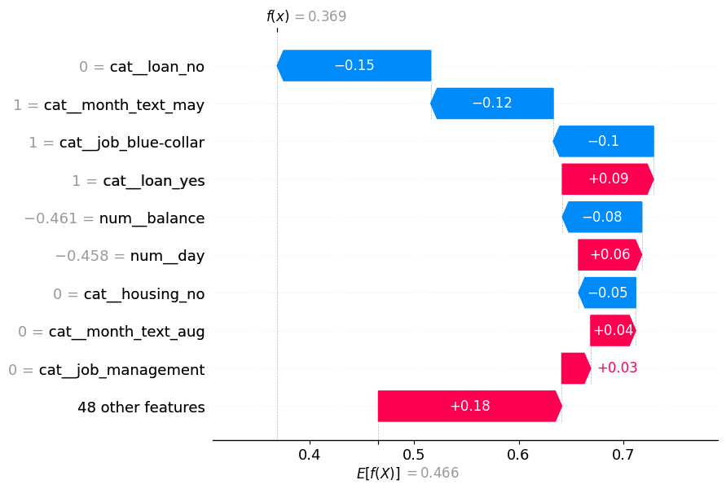
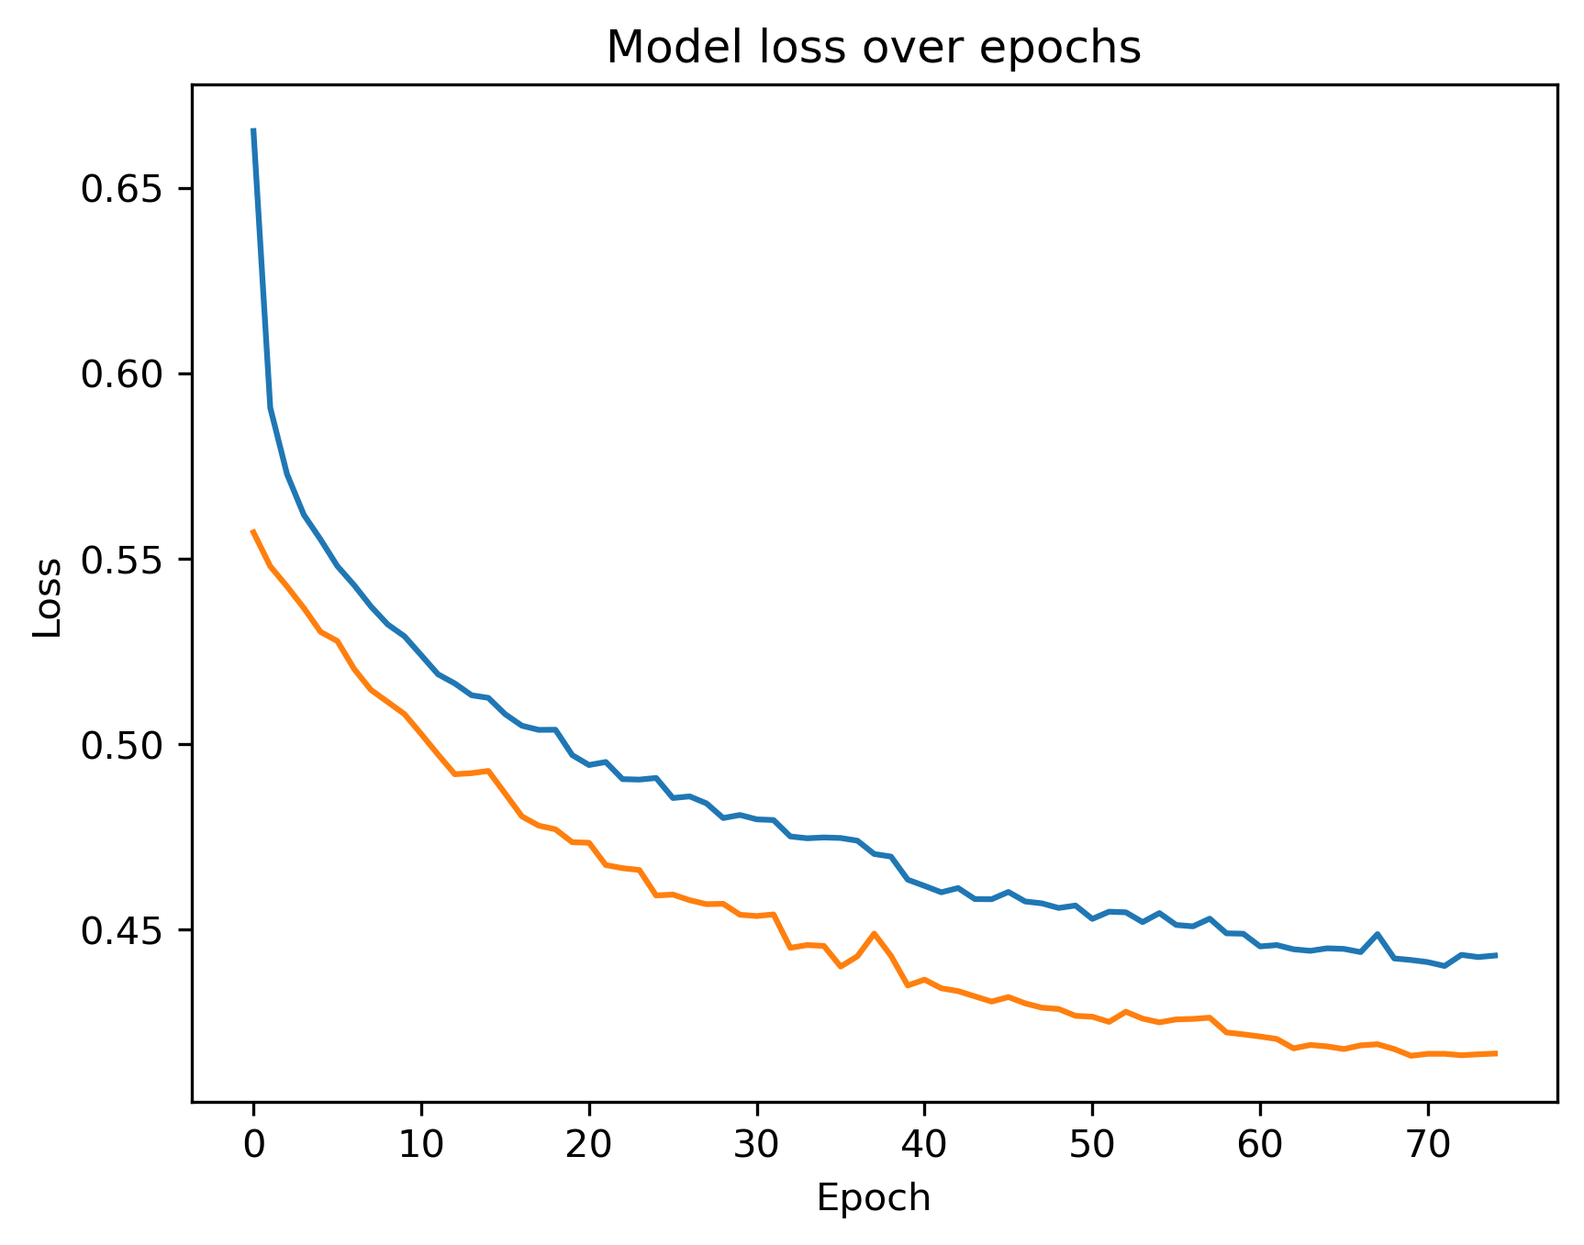
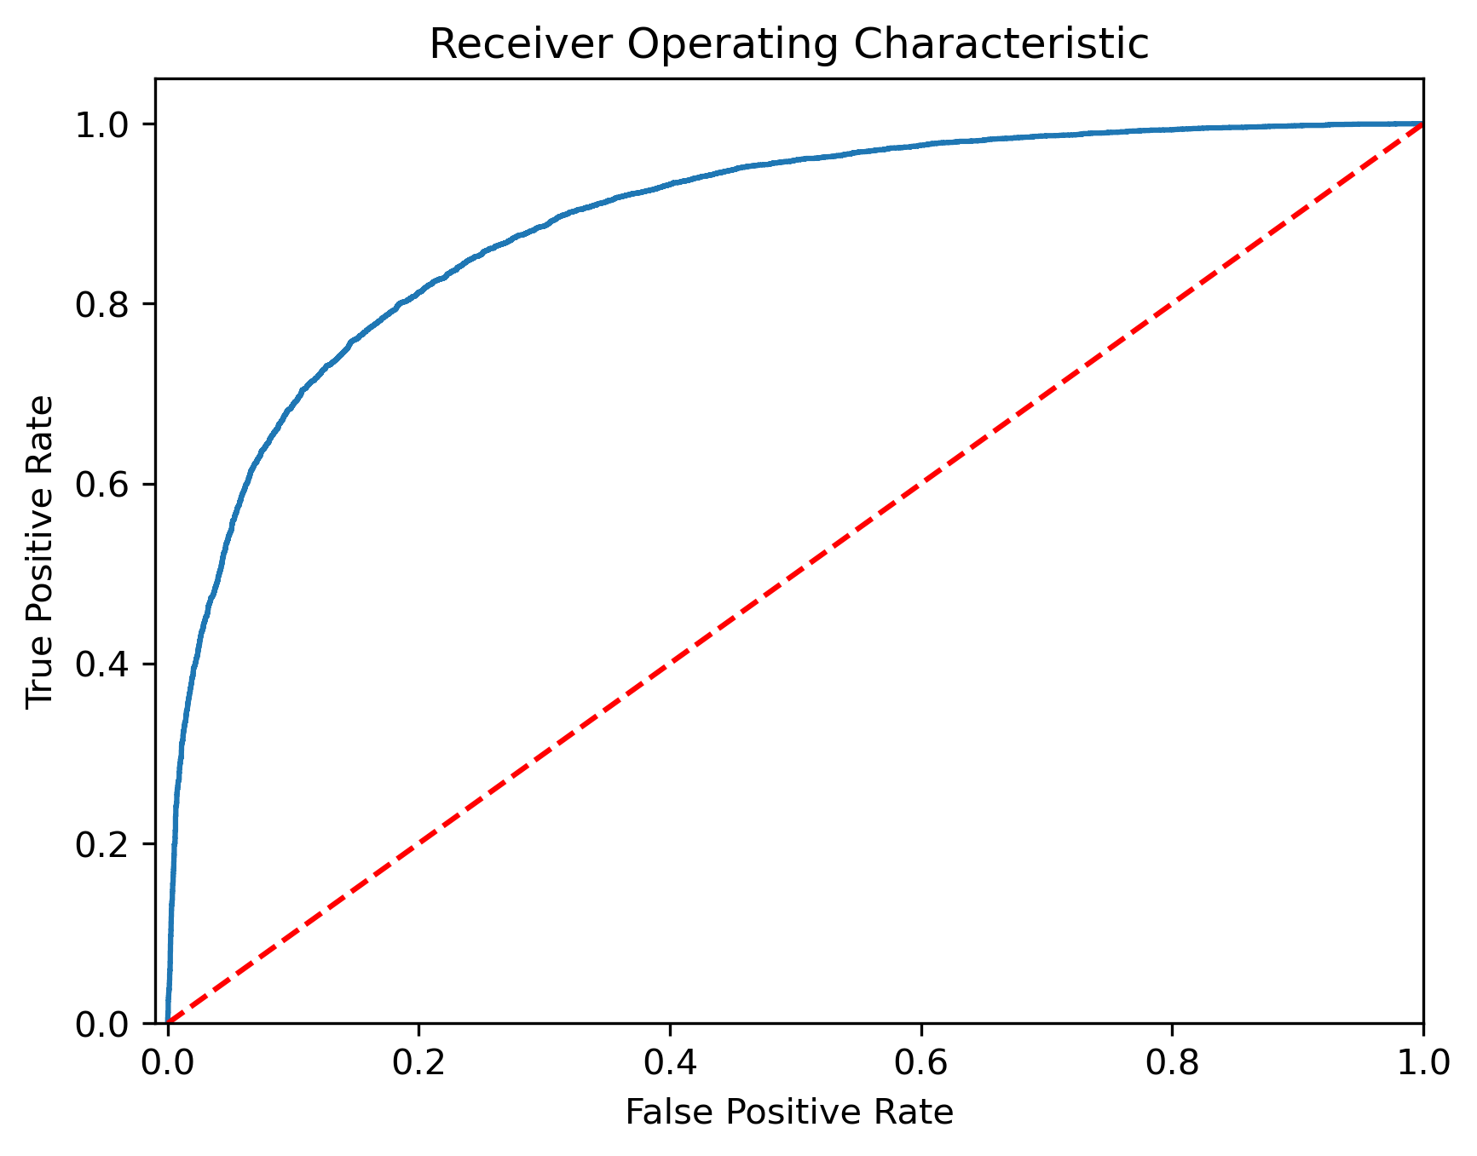
Key Results and Business Impact
High Accuracy, Real Efficiency
Classification report:
 | Precision | Recall | F1-score | Support
0 | 0.79 | 0.83 | 0.81 | 7919
1 | 0.82 | 0.79 | 0.80 | 7943
Accuracy |  |  | 0.81 | 15862
COHORT 6
ML TEAM 7
Notes:
Ritu - 45 sec - 47 seconds
Next we will be speaking to our key results and business impacts. We tested multiple models, Decision Trees gave us clarity, Random Forests added robustness, but the Neural Network delivered the best balance of performance and scalability.
It captured complex patterns with high precision and recall, reaching 81% overall accuracy. SHAP analysis helped us explain predictions by highlighting key drivers like campaign outcome, account balance, and job type.
The ROC curve confirmed clear class separation.
This isn’t just technical success, it’s a strategic win that empowers marketing teams to focus efforts and make smarter, data-backed decisions.

Slide 6
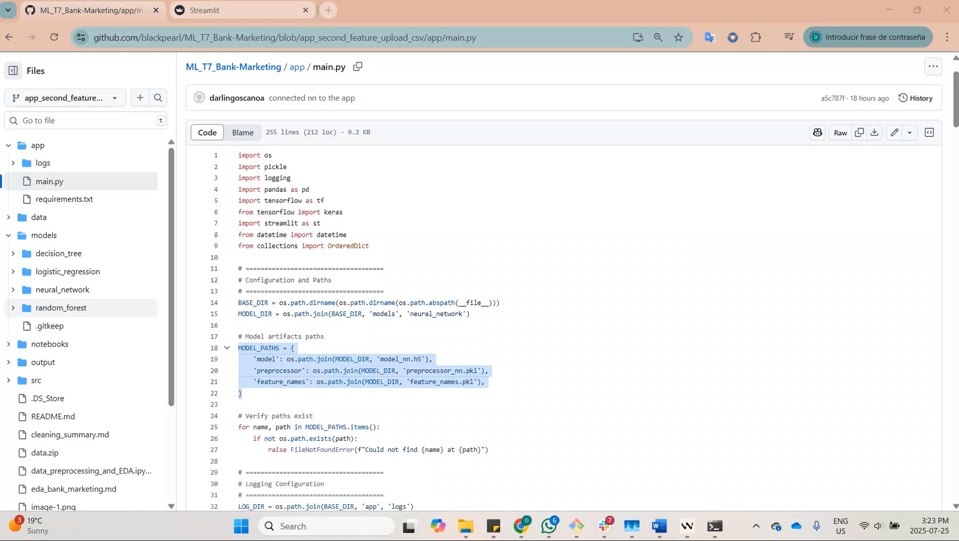
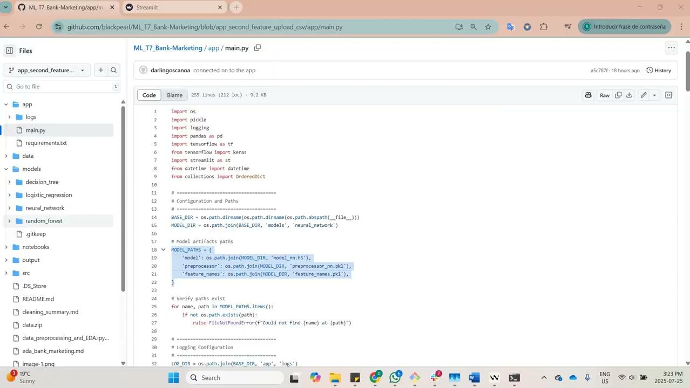
App Demo Video
6
COHORT 6
ML TEAM 7
Notes:
Darling - 1min
[0:00–0:13 — Show GitHub Repo] "We trained several models and chose the neural network for this Streamlit app. In main.py, customer features from the original dataset are set with default values for easy prediction."
[0:13–0:28 — Demo App UI user features] "This is our 'Bank Term Deposit Predictor' app. With default inputs, the app predicts a low subscription likelihood. I update a few features like credit default status and click Predict again."
(Pause briefly, adjusting)
"Now, the likelihood is above 60%, prompting the app to recommend to marketing contact for lead prioritization."
[0:28–0:45 — Demo App UI batch upload] "Next, we upload a batch of 100 customers. The app summarizes the dataset—showing from the total 100 customers, 14 of them with a high likelihood over 60%, plus distributions of key features like job, month, and housing loans."
"Marketing can focus calls on these 14 high-probability leads identified by the model."
[0:45–0:50 — Show logs] "Finally, here are the logs in the terminal, tracking everything for debugging."

Slide 7

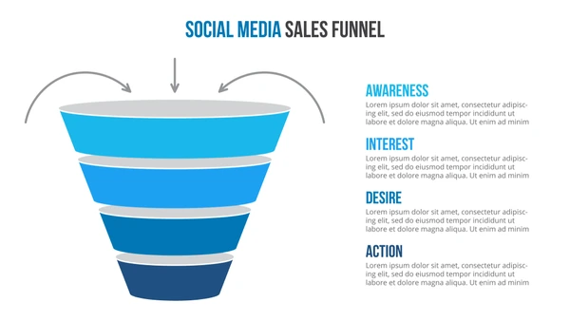
Future Work and Deployment Strategy
What Happens Next?
Retraining with new data
All Clients
Uplift modeling
Predictive Modelling
CRM integration
Predicted Leads
Add behavioural features
Personalized
Outreach
7
COHORT 6
ML TEAM 7
Notes:
Fei - 30 sec - 47 sec
As you can see from our demo, our model is already live, scoring new clients and generating ranked lead lists for outreach.
But this is just the beginning. We’re planning to enhance performance by adding behavioral features like mobile usage and channel preferences.
Next, we’ll integrate the model into CRM dashboards, giving marketers real-time access to ranked leads.
Over time, we’ll retrain the model with updated data to keep it relevant and explore uplift modeling to measure how much the campaign itself influences behavior.
This isn’t just a predictive tool, it’s the engine behind a more adaptive, data-driven marketing strategy.

Slide 8
Thank You!
COHORT 6
ML TEAM 7

